Slide 1
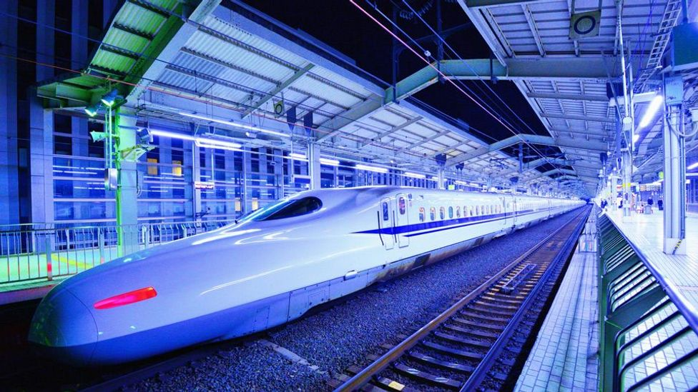
Cybersecurity in intelligent transportation
Saoud al Khelaifi 201908762
Adel hasan 201905244
Mohamed ghoul 201909062
Hosam zarouk 201902702

Slide 2
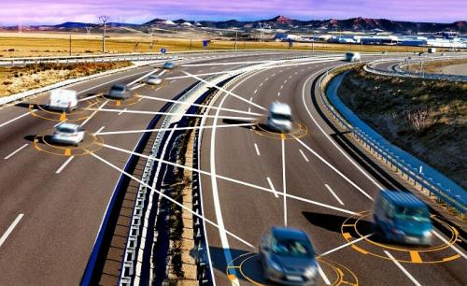
What is intelligent transportation
It is the use of smart cars and smart infrastructure to provide a more comfortable and much safer form of transportation to the public, by using a system that is embedded in smart cars called VANET this allows the cars to communicate with the each other and the infrastructure itself.
There are three forms of communication for the VANET system:
1.Vehicle to vehicle (v2v)
2.Vehicle to infrastructure (v2i)
3. Vehicle to cluster (v2c)

Slide 3
Key fields of its
There are three fields for its
Mobile field: which are the vehicles themselves and mobile devices that contain useful data
Infrastructure field: in this field it is split into two which are central and roadside infrastructures, the central are the traffic lights and the roadside system are the speed cameras.
Generic field: this field is how a device can connect to the VANET system whether directly or indirectly

Slide 4


Key function if c-its (cooperative intelligent transportation)
Revocation: in intelligent transportation vehicle will send notifications to warn cars in the cluster about an accident or incident on the road, and revocation is a system that can detect fake warnings from adversaries by checking the public key if it is revoked or legit
Data collection: in its there are lots of metric data like the weather, speed , direction the car is driving in and the vehicle condition.

Slide 5


Advantages of Intelligent transportation
Increase traffic flow: since smart cars can communicate with the infrastructure like traffic lights, it will allow the lane with the most traffic to go through
Usage of wpa3 )wifi-protected access) enterprise protocol (aes-256, SAE):
Autocrypt technology: autocrypt is a company that is focusing on intelligent transportation cybersecurity by developing components that are installed on new generation cars and creating strong security protocols
Usage of cloud/fog computing to stop ddos by utilizing a blackhole technique.

Slide 6
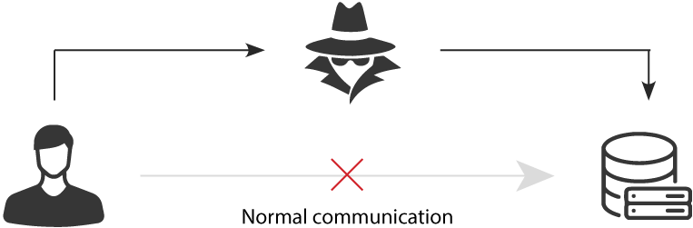
Disadvantages of Intelligent Transportation
Vulnerable to several attacks!
Man-in-the-Middle attack
Malicious entity intercepts communications between autonomous vehicles and other vehicles and infrastructures
Can modify information such as lane change requests, proximity information, occlusion alerts, etc.

Slide 7
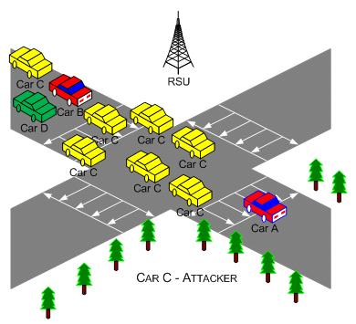
Disadvantages of Intelligent Transportation
Vulnerable to several attacks!
Sybil attack
Malicious vehicle (or vehicles) frequently sends several requests across the networks
Prevents genuine ITS vehicles from communicating and retrieving important information such as the proximity and travelling speed of incoming vehicles
Disrupts proximity alerts, hazard alerts, driving condition alerts and other vital features in intelligent transportation

Slide 8
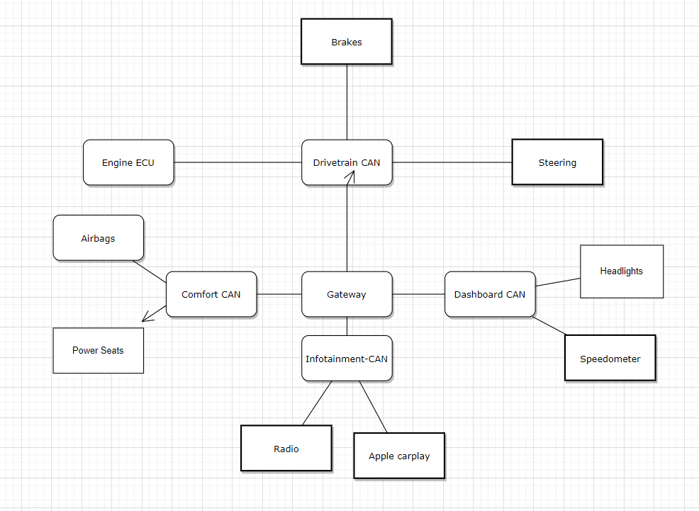
Disadvantages of Intelligent Transportation
Vulnerable to several attacks!
CAN bus attack
Attackers can remotely hack into the CAN and gain access to several vital parts of the vehicle such as engine transmission, steering, airbags, etc.
Could have some serious consequences in certain situations such road dangers and accidents that could harm the ITS vehicle passengers and passengers from other cars as well
Attack is also possible on FlexRay, a successor of the CAN bus
https://www.wired.com/2015/07/hackers-remotely-kill-jeep-highway/

Slide 9
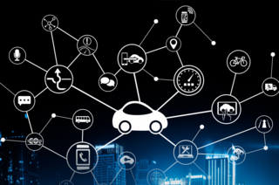
C-ITS
C-ITS is a form of Intelligent Transportation System (ITS).
Can be implemented in vehicles and cars.
Cars with C-ITS technologies implemented are expected to fulfil individual expectations such as privacy and safety.
Vehicles with C-ITS implemented within them communicate via wireless transmissions.
Creates an integrated network of vehicles that links vehicles to roadway infrastructure.

Slide 10
Key Functions of C-ITS
Revocation is one of the first functions of C-ITS.
Vehicles can alert other vehicles by sending wireless transmissions.
Vehicles and trucks act as nodes when communicating.
Maintains security and trust by having vehicles alert other nodes of invalid or corrupted certificates.

Slide 11
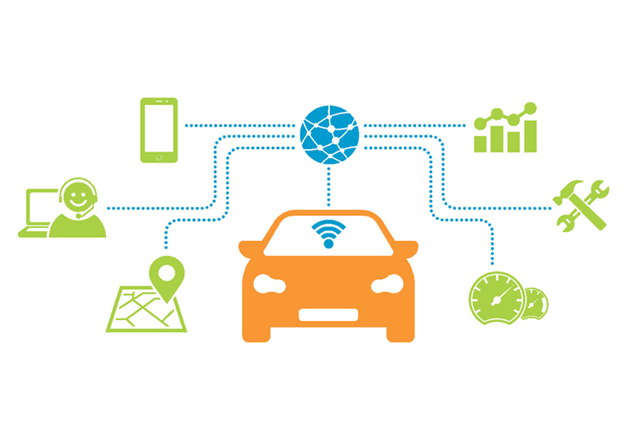
Continue
Driving data collection is another key function of C-ITS
Vehicles with C-ITS implemented in them can collect driving data such as vehicle’s location , speed and condition, through the driver’s consent.
Vehicles have device’s inside of them called on-board units (OBU) that the driving data are collected through.
Driving data that has been collected will be stored on data center that is accessed by transportation infrastructure developers and regulators.
Those people use this data to further improve the transportation infrastructure and the safety of the roads.

Slide 12
Key Applications of ITS
ITS can be utilized in numerous applications.
We can use ITS to improve the traffic flow in roads by the reducing congestion.
Cars that utilize C-ITS technologies can send wireless transmissions to other vehicles to alert them about congestion-inducing incidents.
This can reduce accidents and congestion.

Slide 13

Continue
ITS can be used in Data Management and Archiving.
In order to achieve this , software and relational databases are required for storing , managing and archiving network data.
All this is linked together by Archived Data Management Systems (ADMS).
ADMS takes travel data that is collected to improve transport operations , planning and decision-making at a lower additional cost.

Slide 14
Future works
In ITS numerous technologies are still being researched on how they can be more secure from hackers and adversaries as they are still not cyber-secure.
Transitioning to cars sending and receiving data.
Need to find a way to have vehicles sending and receiving data securely without any interception from adversaries.
Finding a way to have vehicles send and receive data securely while they are undergoing longitudinal challenges. This can be tough challenge and require intensive amount of research.

Slide 15
Future works – Continue
C-ITS Public Key infrastructures (PKI) are being developed to support ITS technologies.
Requires the vehicle tor remain anonymous from other cars around it and the roadside infrastructure.
Also , cars should be completely anonymous from certificate authorities and the car’s components that make up the certification distribution system.
This sounds easy on paper , However achieving this level of anonymity requires more complex systems and protocols to maintain. Which means more research about this is required for the future.

Slide 16
DISCUSSION – SURVEY
A survey was conducted on the Intelligent Transportation System (ITS) among Qatar University students, in which some important issues related to the Intelligent Transportation System were raised. 40 responses were obtained from the students, and in the following, these responses will be discussed and analyzed with the use of charts to give an overview or a general picture of the answers.

Slide 17

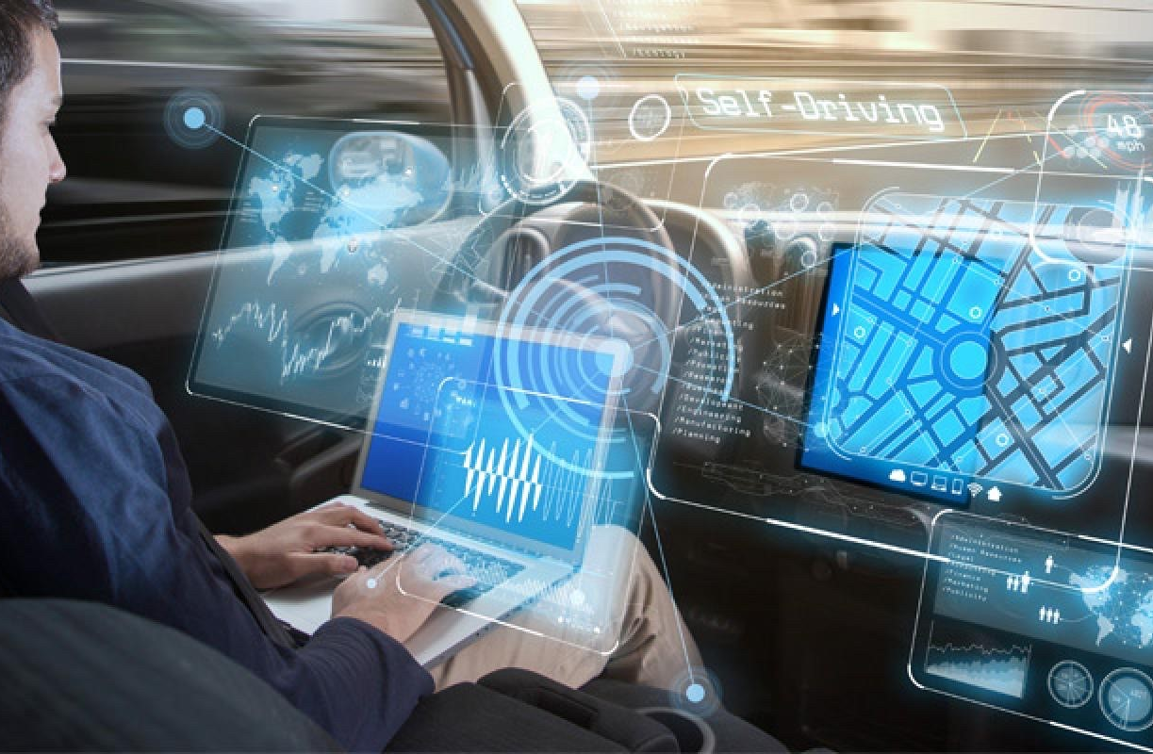
SURVEY – OBJECTIVES
Find out how familiar people are with ITS.
Find out how much people trust ITS technology.

Slide 18
SURVEY – QUESTIONS
1. Do you know what is Intelligent Transportation System (ITS)?
2. How safe would you feel as a passenger if you are in a smart self driving car?
3. Would you trust an Intelligent computer to transport you to your everyday destination?
4. Do you think that Intelligent Transportation System (ITS) is a good move to make in the meantime or wait until more secure issues are resolved?
5. To what extent do you think Intelligent Transportation Systems (ITS) are secure from crimes such as car theft?

Slide 19

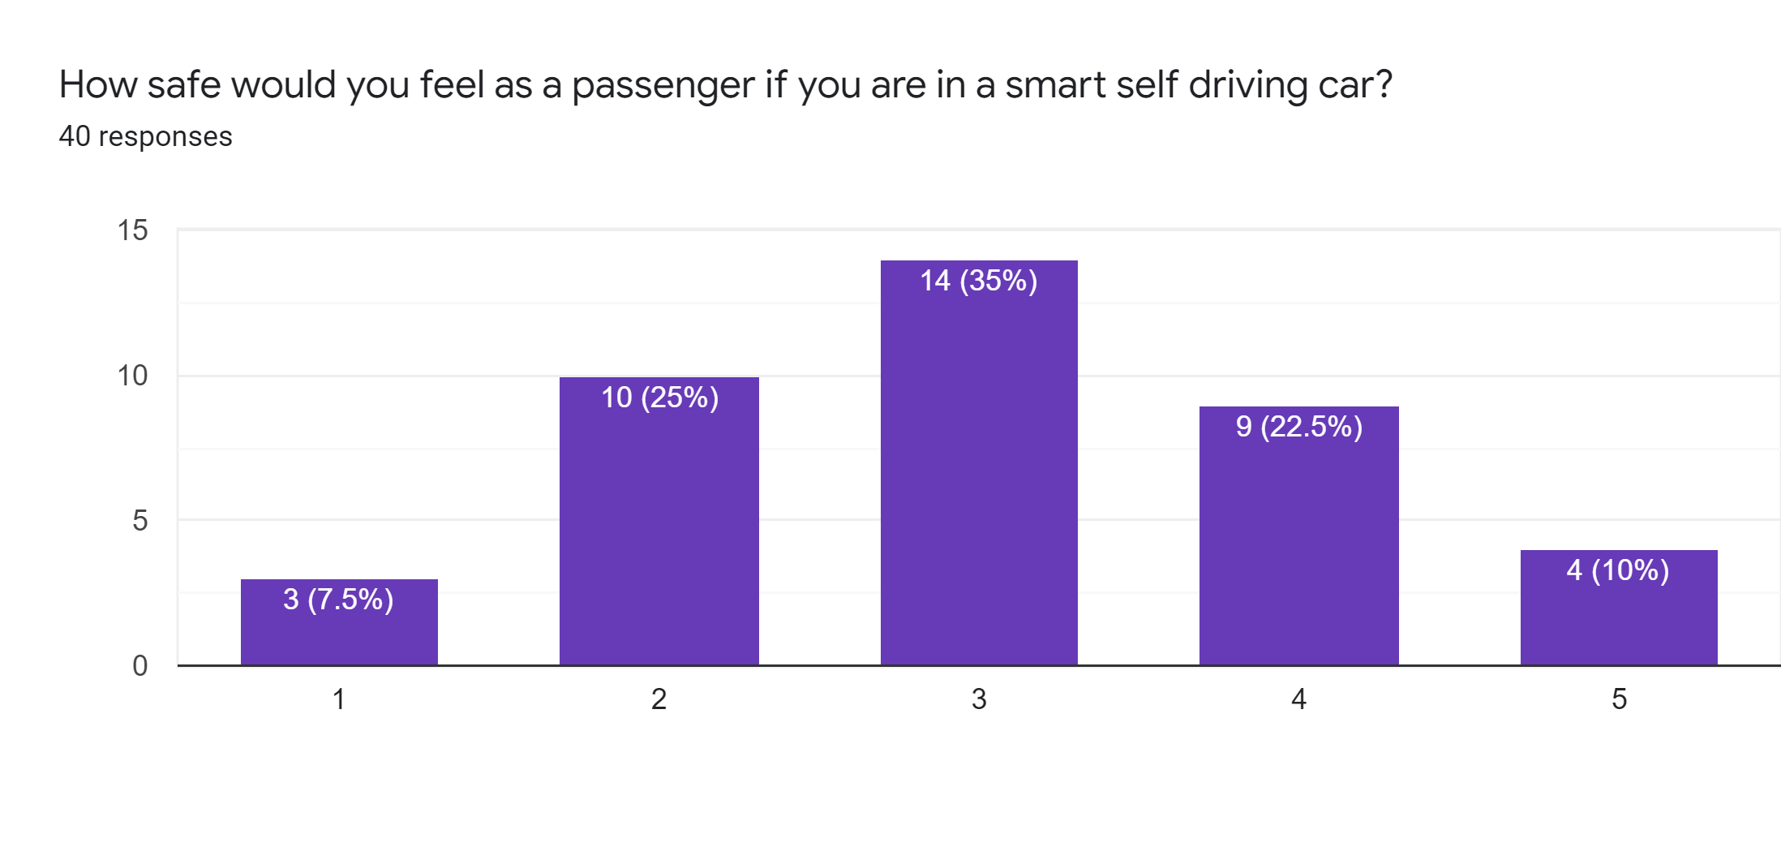
SURVEY – INTERESTING RESULTS
it can be seen that the majority felt anxious (not feeling that comfortable) while in a smart self-driving car, where only 7.5 percent felt completely not comfortable. This may arise to many reasons especially the lack of guarantee that they will reach their destination safely.
The bar chart illustrates the number of responses in a scale that indicates how comfortable they are when they are in a smart self-driving car (1-not comfortable, up to 5-comfortable).

Slide 20
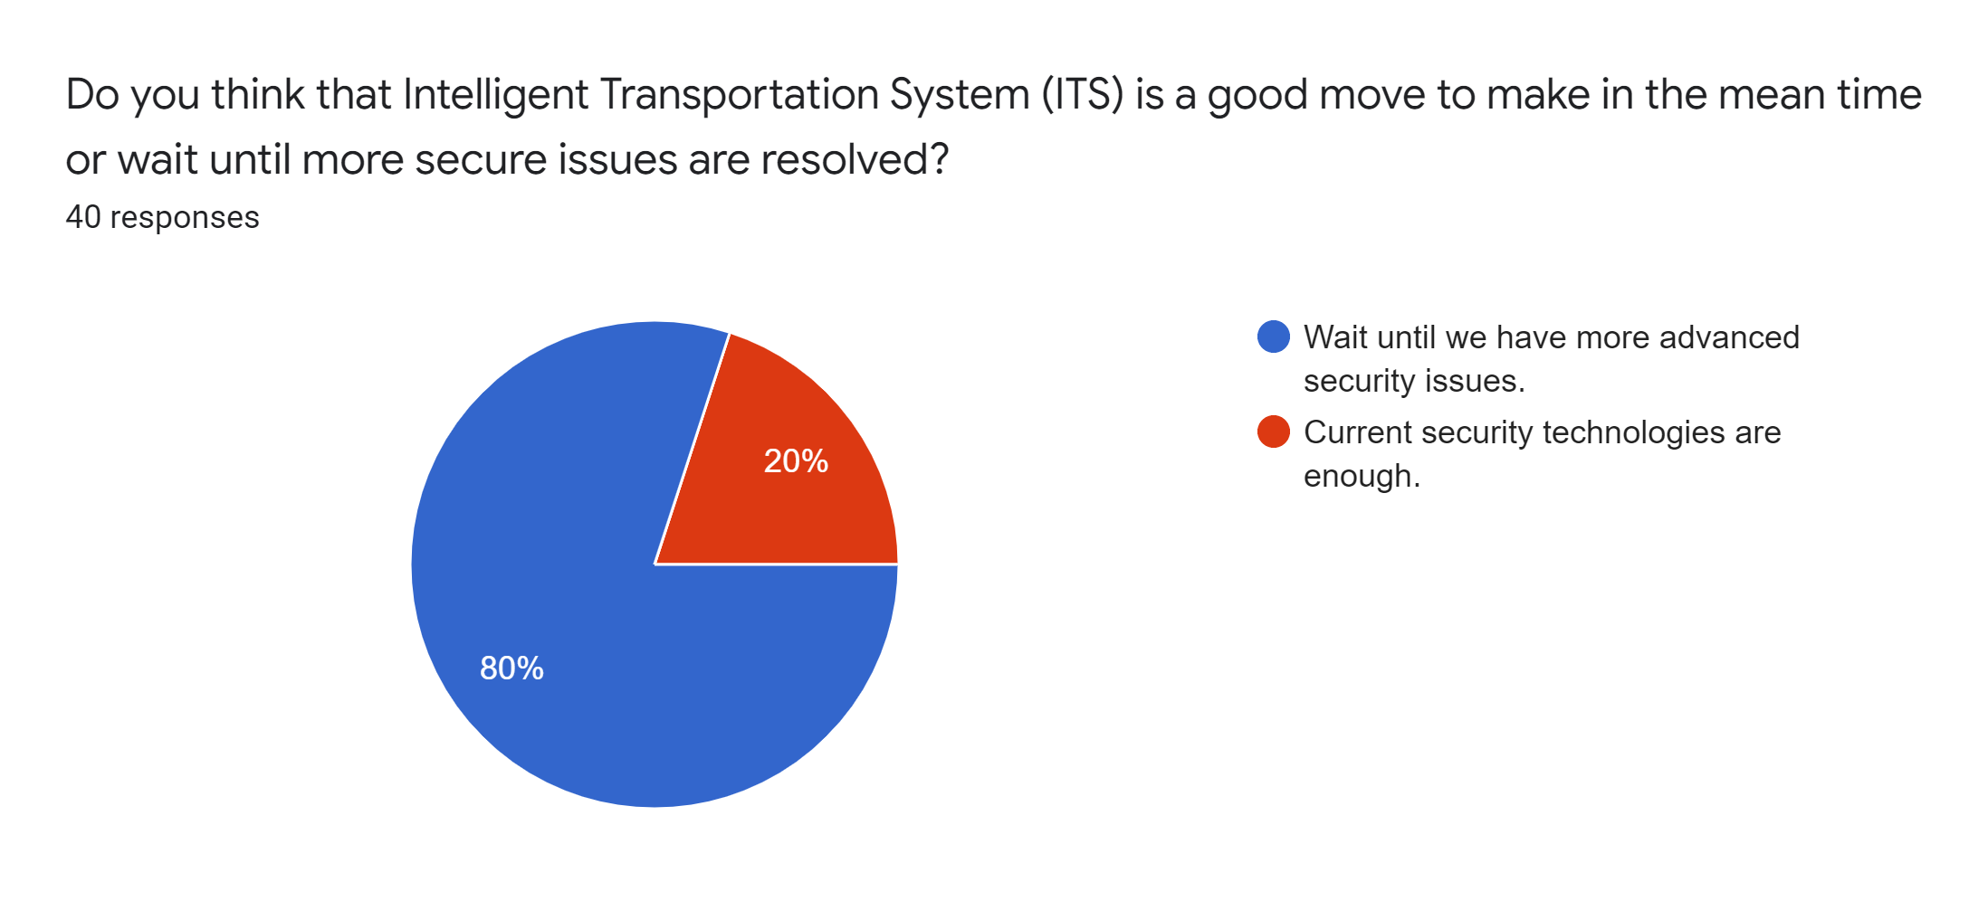
SURVEY – INTERESTING RESULTS
According to the responses, we can see that eighty percent agreed that we should wait until we progress further on security issues, while twenty percent believed that current security technologies are sufficient
The pie chart shows the results about using the Intelligent Transportation System (ITS).

Slide 21
SURVEY – RECOMMENDATIONS AND CONCLUSIONS
Recommendations:
Avoid using any technology related to ITS unless you are sure of its security and the strength of the encryption used, so as not to be hacked by one of the bad guys.
Conclusions:
Despite the development of ITS in the current era, most people are worried (or not confident) about this technology, and they are waiting for a greater development of it. In contrast, we see many people using this technology in their daily lives.

Slide 22
Conclusion
Intelligent transportation seems to be on the rise since more and more car companies are switching to electric smart cars and since the population is growing exponentially every year traffic is soon to follow and worse traffic jams may occur, not only car companies are making a move towards ITS but also cybersecurity companies like AutoCrypt which are already working multiple encryption components to add the upcoming smart cars for the next generation, but that doesn’t mean that ITS will be secure forever since data Is valuable hacker and malicious companies will find ways to either steal or cause physical harm to the public.

Slide 23
Quick Disclaimer

